Slide 1

Hyderabad Python Users Group

Slide 2

Data Quality Through Contracts

Slide 3
Problem-1
a glitch in the billing software allowed a customer to use a coupon multiple times, bypassing the intended limit
Notes:
How many of you believe data quality is a major challenge in your organization

Slide 4
Business Impact?

Slide 5
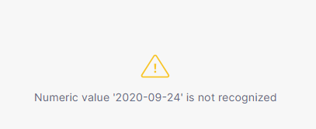
Problem-2

Slide 6
In God we trust; all others bring data

Slide 7
Data Contracts

Slide 8
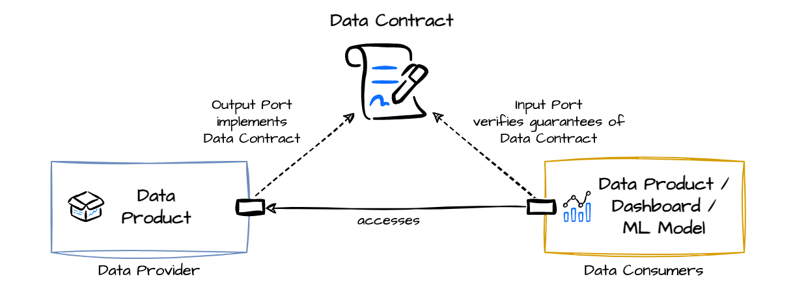
What is data contract?
A data contract specifies the format, structure, and validation rules for the data exchanged between different components of a system

Slide 9
Contents
Schema Definition: Defines the structure of data (e.g., coupon ID, validity, expiration date, usage limit).
Validation Rules: Specifies the rules data must follow (e.g., "Coupon is one-time use only").
Ownership and Responsibility: Clarifies which system owns the data and is responsible for enforcing rules.
Version Control: Allows changes to be made to contracts over time without breaking systems.

Slide 10
Advantages
Improved Data Consistency: Ensures the same rules and validations across all systems.
Reduced Errors: Prevents the types of glitches like the one discussed.
Faster Bug Resolution: Clear data ownership and validation rules help identify and fix issues quickly.
Scalability: Data contracts can scale with growing telecom services, ensuring continuous integrity as systems evolve.

Slide 11
Tools
DataContracts-cli
DataContracts Playground
DataHub
Soda – Data Quality Tool

Slide 12
Open Data Contract Standard
a standardized data contract format designed to provide a common framework for data practitioners

Slide 13
Contributors of Data Contracts
Data Engineers
Data Scientists
Product Owners
Automation Tools

Slide 14
Demo
Build an ETL pipeline to extract data from
https://www.espncricinfo.com/records/most-runs-in-career-223646
Transform the data to create a new columns

Slide 15
Thank you

